Slide 1
Chapter 2
Asymptotic Performance

Slide 2
Review: Asymptotic Performance
Asymptotic performance: How does algorithm behave as the problem size gets very large?
    Running time
    Memory/storage requirements
  Remember that we use the RAM model:
    All memory equally expensive to access
    No concurrent operations
    All reasonable instructions take unit time
      Except, of course, function calls
    Constant word size
      Unless we are explicitly manipulating bits

Slide 3
Review: Running Time
Number of primitive steps that are executed
  Except for time of executing a function call most statements roughly require the same amount of time
  We can be more exact if need be
Worst case vs. average case

Slide 4
Sequential searching algorithm
int search(int item, int A[], n){
for (int i=0;i<n;i++){
if (A[i]==item)
return i;
}
return -1;
}
Wc | Bc | Ac
n | 1 | 1
c1n | 1 | 2
0 | 1 | 3 .
1 | 0 | n
worst case: T(n)= n+c1n + 0+1= O(n)
Best case: T(n)= 1+1 + 1+0= O(1)
Average case: T(n)= (1+2 + 3+…+n)/n= n(n+1)/2n=O(n)

Slide 5
Finding the minimum value
Wc | Bc | Ac
c₁ | c₁ | c₁
n | n | n
c₂n | c₂n | c₂n
c₃n | 0 | c₃n/2
1 | 1 | 1
int Min(int A[], n){
int m=A[0];
for (int i=1;i<n;i++){
if (A[i]<m)
m=A[i];
}
return m;
}
worst case: T(n)= c1 + n+ c₂n + c₃n +1= O(n)
Best case: T(n)= c1 + n+ c₂n + 0 +1= O(n)
Average case: T(n)= c1 + n+ c₂n + c₃n/2 +1= O(n)

Slide 6
Example of computational problem: Sorting
Statement of problem:
  Input: A sequence of n numbers <a₁, a₂, …, a_{n}>
  Output: A reordering of the input sequence <a´₁, a´₂, …, a´_{n}>
so that a´_{i} ≤ a´_{j} whenever i < j
Instance: The sequence <5, 3, 2, 8, 3>
Output : <2, 3, 3, 5, 8>
Algorithms:
  Bubble sort
  Selection sort
  Insertion sort
  Merge sort
  (many others)

Slide 7
Bubble Sort
Compares adjacent array elements
  Exchanges their values if they are out of order
Smaller values bubble up to the top of the array
  Larger values sink to the bottom

Slide 8
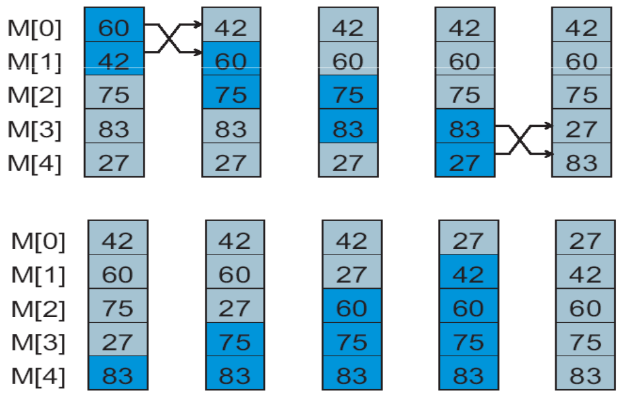
Bubble Sort: Example
One Pass
Array after
Completion
of Each Pass

Slide 9
Bubble Sort
for i = 1 to n n
for j = 1 to i T
if A[j] > A[j+1] { c1T
Temp = A[j] c2T
A[j]=A[j+1] c3T
A[j+1]=Temp c4T
}

Slide 10
Analyzing Bubble Sort
T(n) = n+ T + c1T + c2T + c3T + c4T
What can T be? T=1+2+3+…+n=n(n+1)/2
Number of comparisons (worst case):
(n-1) + (n-2) + ... + 3 + 2 + 1 → O(n²)
Number of comparisons (best case):
n – 1 → O(n²)
Number of swaps (worst case):
(n-1) + (n-2) + ... + 3 + 2 + 1 → O(n²)
Number of swaps (best case):
0 → O(1)
Overall worst case: O(n²) + O(n²) = O(n²)
Average case O(n²)

Slide 11
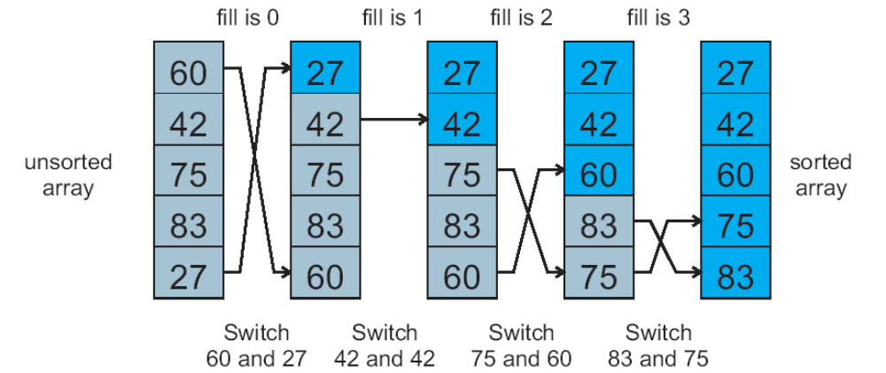
Selection Sort: Example
Check every item A[i],
find the minimum value in the array,
(if the minimum < A[i] then swap.

Slide 12
Selection sort
  for i=1 to n
  swap a[i] with smallest of a[i],…a[n]
The same as the Bubble sort, The inner loop to find the minimum value take T time
Worst and average case T= 1+2+3+…+n=n(n+1)/2 : o(n²)
Best case when it is sorted and no swaps needed, but still the algorithm has to find the minimum all the time so the worst case is still o(n²)

Slide 13
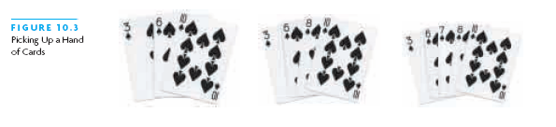
Insertion Sort
Based on technique of card players to arrange a hand
  Player keeps cards picked up so far in sorted order
  When the player picks up a new card
    Makes room for the new card
    Then inserts it in its proper place

Slide 14
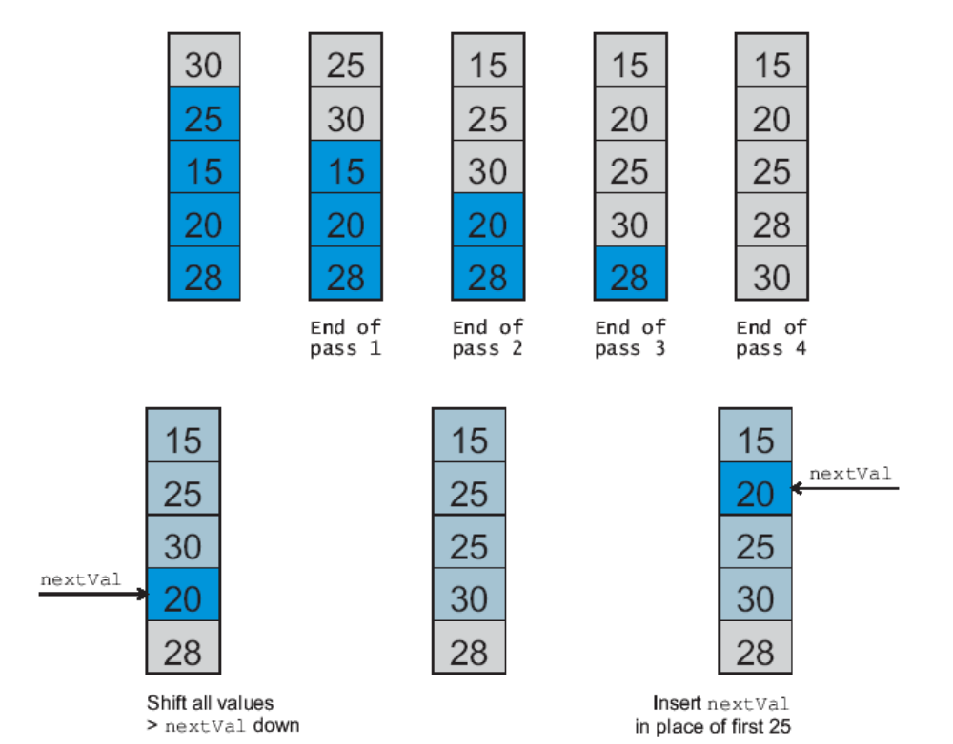
Insertion Sort: Example
Insertion Sort:
4 passes
Pass 3

Slide 15
Insertion Sort algorithm
Statement Effort
InsertionSort(A, n) {
for i = 2 to n { c₁(n-1)
key = A[i] c₂(n-1)
j = i - 1; c₃(n-1)
while (j > 0) and (A[j] > key) { c₄T
A[j+1] = A[j] c₅T
j = j - 1 c₆T
} 0
A[j+1] = key c₇(n-1)
} 0
}
T = t₂ + t₃ + … + t_{n} where t_{i} is number of while expression evaluations for the i^{th} for loop iteration

Slide 16
Analyzing Insertion Sort
T(n) = c₁(n-1) + c₂(n-1) + c₃(n-1) + c₄T + c₅T + c₆T + c₇(n-1)
= c₈T + c₉n + c₁₀
What can T be?
  Best case -- inner loop body never executed
    t_{i} = 1 ➔ T(n) is a linear function
  Worst case -- inner loop body executed for all previous elements
    t_{i} = i ➔ T(n) is a quadratic function: o(n²)
  Average case
    T(n) is a quadratic function too: o(n²)

Slide 17
Analysis
Simplifications
  Ignore actual and abstract statement costs
  Order of growth is the interesting measure:
    Highest-order term is what counts
      Remember, we are doing asymptotic analysis
      As the input size grows larger it is the high order term that dominates

Slide 18
Upper Bound Notation
We say InsertionSort’s run time is O(n²)
  Properly we should say run time is in O(n²)
  Read O as “Big-O” (you’ll also hear it as “order”)
In general a function
  f(n) is O(g(n)) if there exist positive constants c and n₀ such that f(n) ≤ c ⋅ g(n) for all n ≥ n₀
Formally
  O(g(n)) = { f(n): ∃ positive constants c and n₀ such that f(n) ≤ c ⋅ g(n) ∀ n ≥ n₀

Slide 19
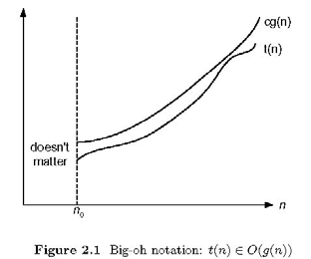
Upper Bound Notation
  e.g. f(n) = 10n² + 4n + 2
  then, f(n) = O(n²), or O(n³), O(n⁴), …

Slide 20
Lower Bound Notation
We say InsertionSort’s run time is Ω(n)
In general a function
  f(n) is Ω(g(n)) if ∃ positive constants c and n₀ such that 0 ≤ c⋅g(n) ≤ f(n) ∀ n ≥ n₀

Slide 21
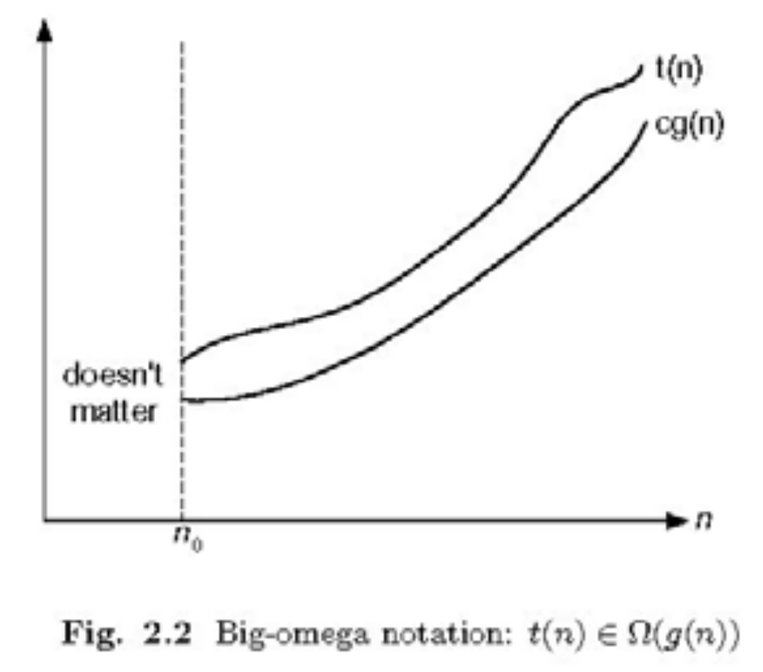
Lower Bound Notation
  e.g. f(n) = 10n² + 4n + 2
  then, f(n) = Ω(n²), or Ω(n), Ω(1)

Slide 22
Asymptotic Tight Bound
A function f(n) is Θ(g(n)) if ∃ positive constants c₁, c₂, and n₀ such that
c₁ g(n) ≤ f(n) ≤ c₂ g(n) ∀ n ≥ n₀
Theorem
  f(n) is Θ(g(n)) iff f(n) is both O(g(n)) and Ω(g(n))

Slide 23
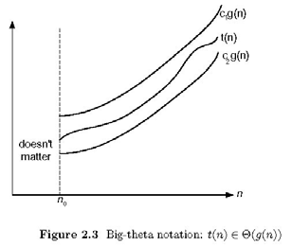
Asymptotic Tight Bound
  e.g. f(n) = 10n² + 4n + 2
  then, f(n) = Ω(n²), and f(n)=O(n²), therefore, f(n)= Θ (n²)

Slide 24

Practical Complexity

Slide 25

Practical Complexity

Slide 26

Practical Complexity

Slide 27

Practical Complexity

Slide 28
Homework 1
Write c++ programs for the Bubble, insertion and selection sort algorithms, run the programs to sort random integers in dynamic array of length starting from your university last 4 digits, and double the number 6 times. E.g if your number ends with 1100, then the size of the array should be 1100, 2200, 4400, 8800, 17600, 35200, and 70400, record the consumed time each run, and draw a chart showing the performance of each algorithm.

Slide 29
Lab work // buble sort algorithm
#include <cstdlib>
#include <iostream>
#include <time.h>
using std::cout;
using std::cin;
using std::endl;
int main(){
long n;
cout<<" Enter the size of the array:";
cin >> n;
cout<<endl;
int *ar= new int [n];
//initialize random array
srand (time(NULL) );
long i;
for (i=0;i<n;i++){
ar[i]=rand();
cout<<ar[i]<<endl;//print before sortin
}
cout<<"============"<<endl;
double consumedTime;
long start = clock();
for (i=0;i<n;i++)
for (long j=0;j<i;j++)
if (ar[j]>ar[i]) {
long temp=ar[i];
ar[i]=ar[j];
ar[j]=temp;
}
long end = clock();
//print after sorting
for (i=0;i<n;i++){
cout<<ar[i]<<endl;
}
consumedTime=end-start;
cout <<"algorithm sttarted at :"<<start<< " and ended at:"<<end<<endl;
cout <<"consumed
time:"<<consumedTime/CLOCKS_PER_SEC<<endl;
delete ar;
return 0;
}

